Slide 1
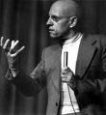
Lecture Five: Foucault (i)

Slide 2
Foucault’s critique of the Enlightenment
“The ‘Enlightenment’, which discovered the liberties, also invented the disciplines.”
The Enlightenment discourses of rationality and human autonomy, which were supposed to free us from oppression, have a hidden disciplinary side – another dimension of domination and regulative power that is all around us in modern societies, and which controls, disciplines and normalises our behaviour in all sorts of ways. Emphasises the ‘dark side’ of the Enlightenment.
The blindspot of liberalism: liberal societies, which are formally defined by free, rights-bearing subjects, do not have the conceptual language to grasp the domination of disciplinary power, which functions as their underside.
The ‘free and autonomous’ liberal subject is himself a construction of power and discourse.

Slide 3
Punishment and Power
Discipline and Punish (Surveiller et Punir)
Why did the dominant mode of punishment change around the late eighteenth century from the public torture/execution to incarceration? What does this say about our society and the forms of power operating within it.
The public execution (the ‘spectacle of the scaffold’) symbolises the power of the sovereign to take life – and is expressed through the literal and symbolic destruction of the body.
The change to imprisonment as the dominant mode of punishment has nothing to do with us being more humane and enlightened – rather it is part of a new economy of punishment and power, and signifies the emergence of disciplinary power.

Slide 4
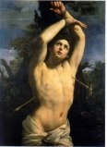
The Body of the Condemned

Slide 5
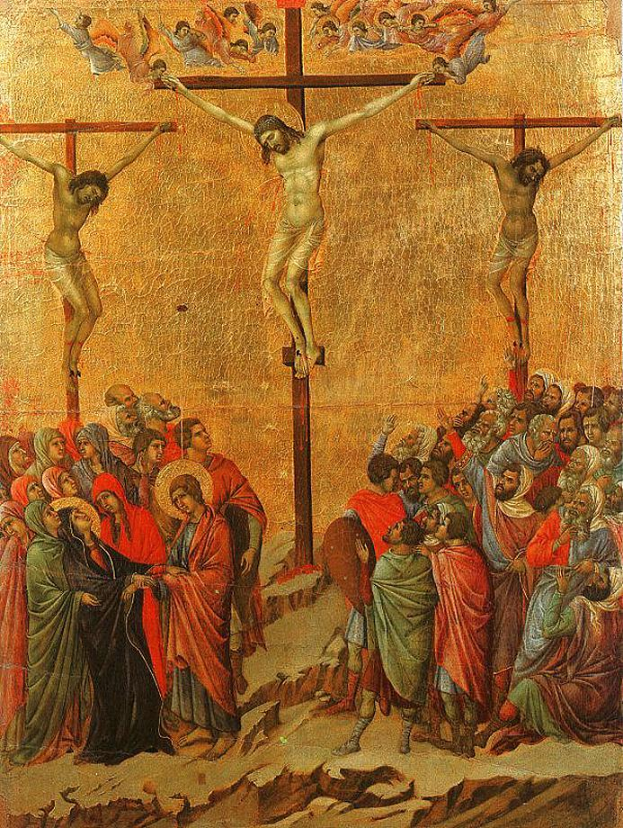
Sovereign punishment: Crucifixion

Slide 6
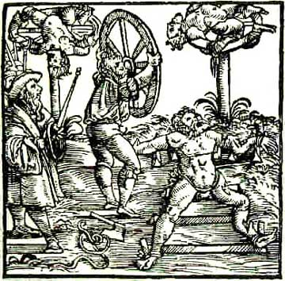
Sovereign punishment: Breaking on the Wheel

Slide 7
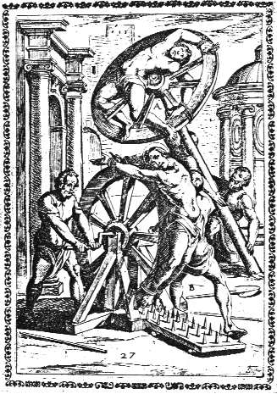
Sovereign punishment: Breaking on the Wheel

Slide 8
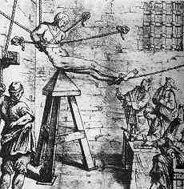
Instruments of punishment: the Judas Cradle

Slide 9
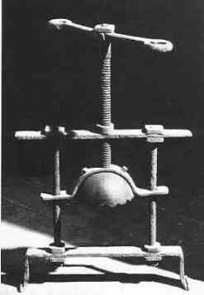
Instruments of punishment: The Head Crusher

Slide 10
Disciplinary Power
A new mode of power which emerges during the C18th and which comes to replace sovereign power.
Disciplinary power works directly on the body, but rather than destroying the body, it seeks to control its movements and regulate its behaviours.
Designed to intensify and more effectively exploit the powers of the body – treats the body as a productive unit.
Body as ‘docile’ – to be moulded and trained to perform certain tasks and functions, to be controlled in certain precise ways.
Form of power which emerges not only in prison, but also in factories, schools, asylums, workshops and hospitals.
Related to the emergence of a series of knowledges and scientific discourses: particularly the human and behavioural sciences – psychiatry/psychology, criminology, anthropology, sociology – which take as their object of study human behaviours and pathologies.
Relationship between power and knowledge – each relies upon and intensifies the others.

Slide 11
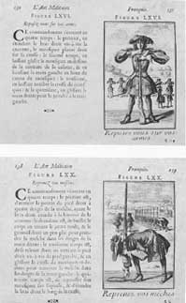
Disciplinary Power: The Military Drill

Slide 12
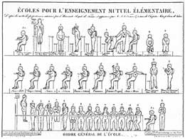
Disciplinary Power: Manual on exercise and posture, C19th

Slide 13
Techniques of disciplinary power: 1) Distribution of individuals in space
  organization of physical space is a political question.
  institutions – new enclosure and division of individuals
  facilitates surveillance and control
  has political function - breaks up mass which is dangerous and unpredictable

Slide 14
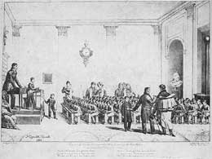
Distribution of individuals in space: school classroom C19th

Slide 15
Techniques of disciplinary power: 2) Control of activity
  timetable allows day to be divided up exactly
  wastage of time is impossible
  means of social and political control - spare time is dangerous
  operates not only in prison, but also in factory - Taylorism

Slide 16
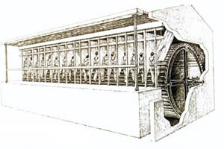
Control of activity: prison treadmill, C19th

Slide 17
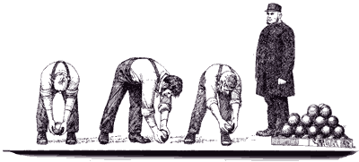
Control of activity: hard labour in prisons, C19th

Slide 18
Techniques of disciplinary power: 3) Normalizing judgement
  subjection of individual to series of norms of behaviour which he/she is expected to conform to
  forms the impression we have of ourselves as ‘normal’
  arbitrary division between normal/abnormal – socially constructed
  creates series of excluded ‘abnormal’ identities

Slide 19
Techniques of disciplinary power: 4) Surveillance
The power of gaze - functions through seeing, observing, making things and individuals visible.
The Panopticon (Bentham):
  makes surveillance and social control more efficient
  position of gaze is concealed – I can see you but you can’t see me
  relies on self-domination – internalisation of the gaze
  allows the automatic function of power – power without an agent

Slide 20
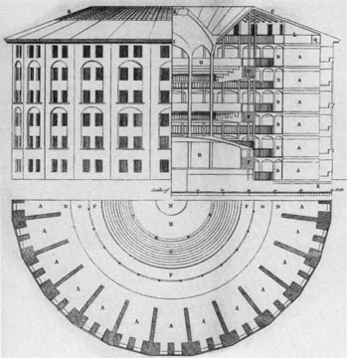
Surveillance: Bentham’s design for Panopticon, C18th

Slide 21
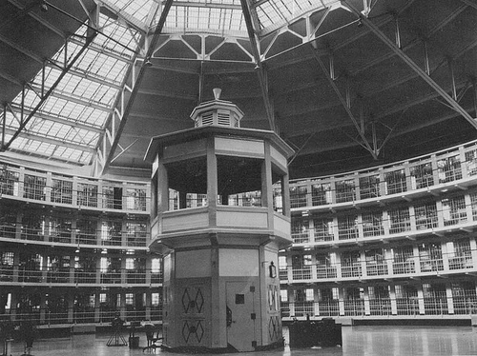
Surveillance: Panopticon in prison: Statesville, PA

Slide 22
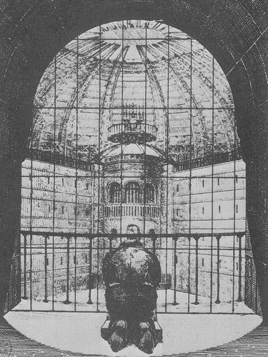
Surveillance: The penitent prisoner

Slide 23
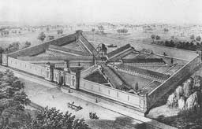
Surveillance: Panopticon design for Eastern State Penitentiary, Philadelphia C19th

Slide 24
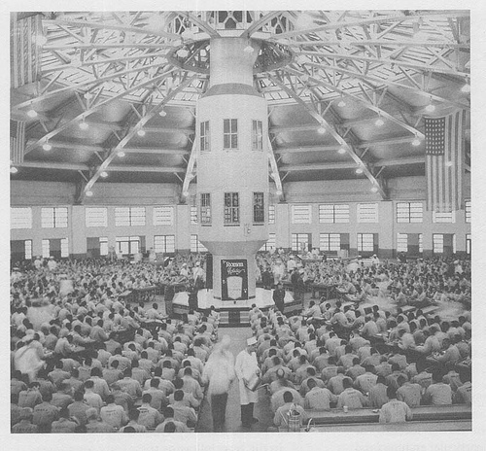
Surveillance: Panopticon in Prison, Statesville PA

Slide 25

The modern panopticon: the CCTV camera

Slide 26
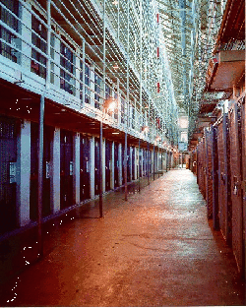
Are prisons justified?

Slide 27
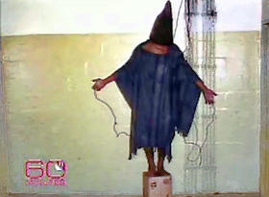
Sovereign punishment meets discipline?: Abu Ghraib

